Slide 1
QA – Automation Tester Certification
Test Automation Engineer – Preparation Course – Session 04

Slide 2
QA – Automation Tester Certification
Content
01. UI Web based application Automation
Selenium Webdriver, BDD Gherkin Language, Specflow, Page Object Model
02. Backend API Rest Automation
GET / POST / PUT / DELETE requests
Postman, ResponsibilityChain pattern
03. UI Android application Automation
Appium, Locators in Android
04. Continuous Integration over Azure Environment
Vstest Executor
Pipelines
Reporting
Selenium Grid
Specsync

Slide 3

01. UI Web based application Automation
Selenium: How to Start a New Project
CI over Azure
Selenium Grid & VsTest executor

Slide 4
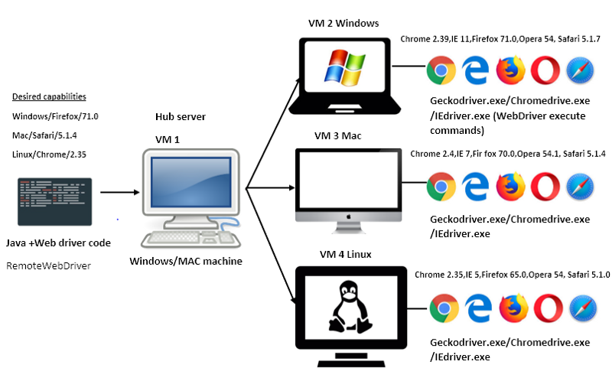
04. Continuous Integration over Azure Environment
4.1 Selenium Grid
Selenium-Grid allows you run your tests on different machines against different browsers in parallel. That is, running multiple tests at the same time against different machines running different browsers and operating systems. Essentially, Selenium-Grid support distributed test execution.

Slide 5
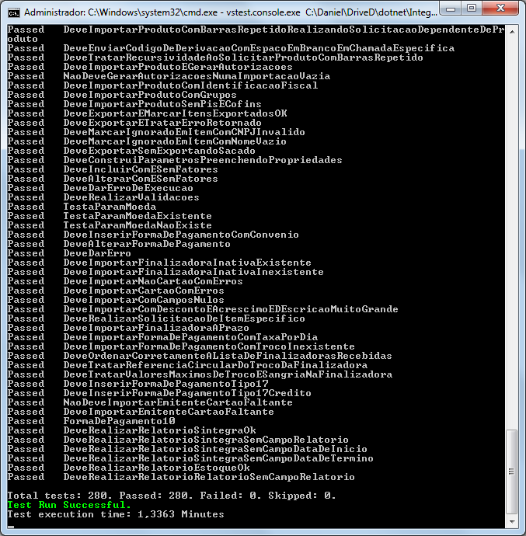
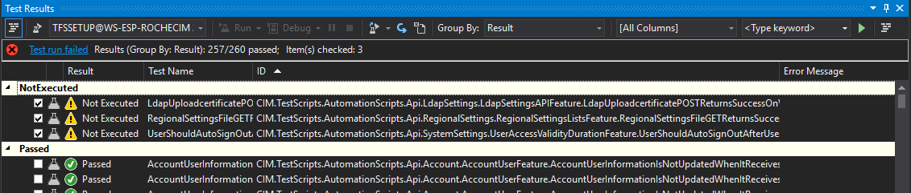
04. Continuous Integration over Azure Environment
4.2 VsTest Executor
The Visual Studio Test Platform is an open and extensible test platform that enables running tests, collect diagnostics data and report results.
Command-line Options: Test File, TestCaseFilter, Logger, etc.
Example:
vstest.console.exe “PathToTestFile.dll" /Logger:trx /TestCaseFilter:"(TestCategory=tag1|TestCategory=tag2)"

Slide 6
01. UI Web based application Automation
Selenium: How to Start a New Project
PRACTICE
Refactor to Remote WebDriver

Slide 7
01. UI Web based application Automation
Selenium: How to Start a New Project
CI over Azure
SpecSync

Slide 8
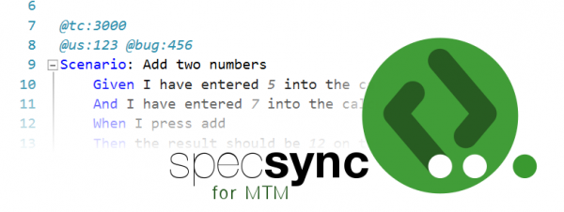
04. Continuous Integration over Azure Environment
4.3 SpecSync
SpecSync for Azure DevOps is a synchronization tool that synchronizes Given/When/Then-based BDD scenarios to Azure DevOps. It supports any tool that uses the Gherkin language for describing the BDD scenarios, for example SpecFlow or Cucumber.
https://specsolutions.gitbook.io/specsync/getting-started/getting-started-specflow
https://specsolutions.gitbook.io/specsync/important-concepts/synchronizing-automated-test-cases
https://www.specsolutions.eu/media/specsync/SpecSync_for_AzureDevOps_Plans_20190115.pdf

Slide 9
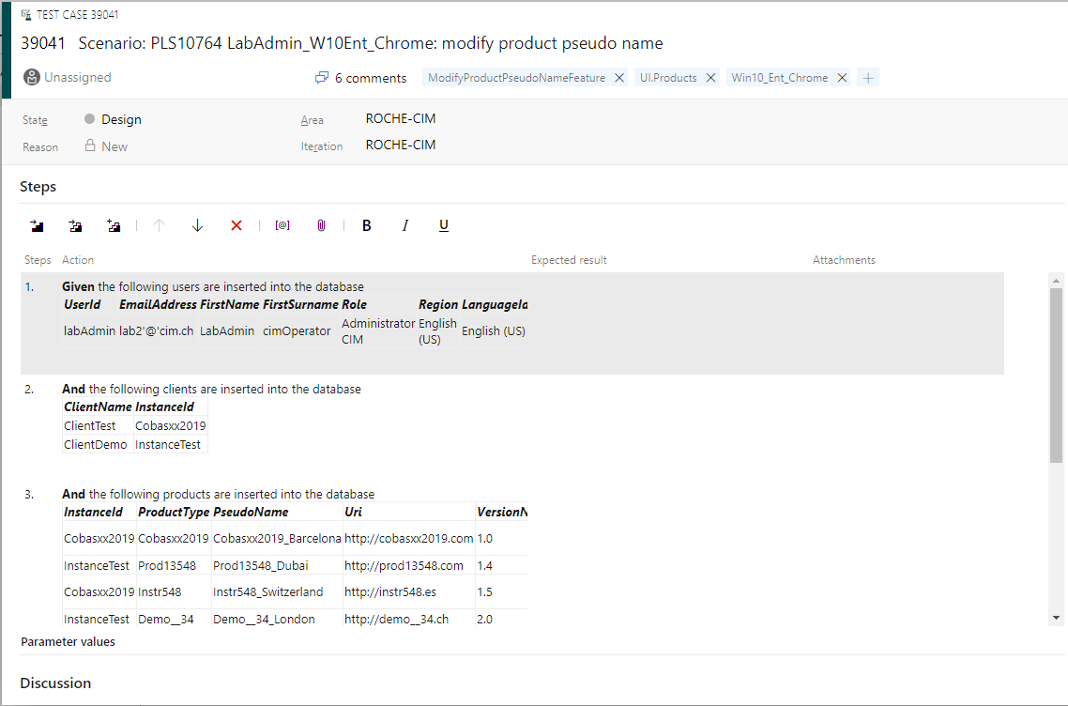
04. Continuous Integration over Azure Environment
4.3 SpecSync – Publish Test Plan

Slide 10
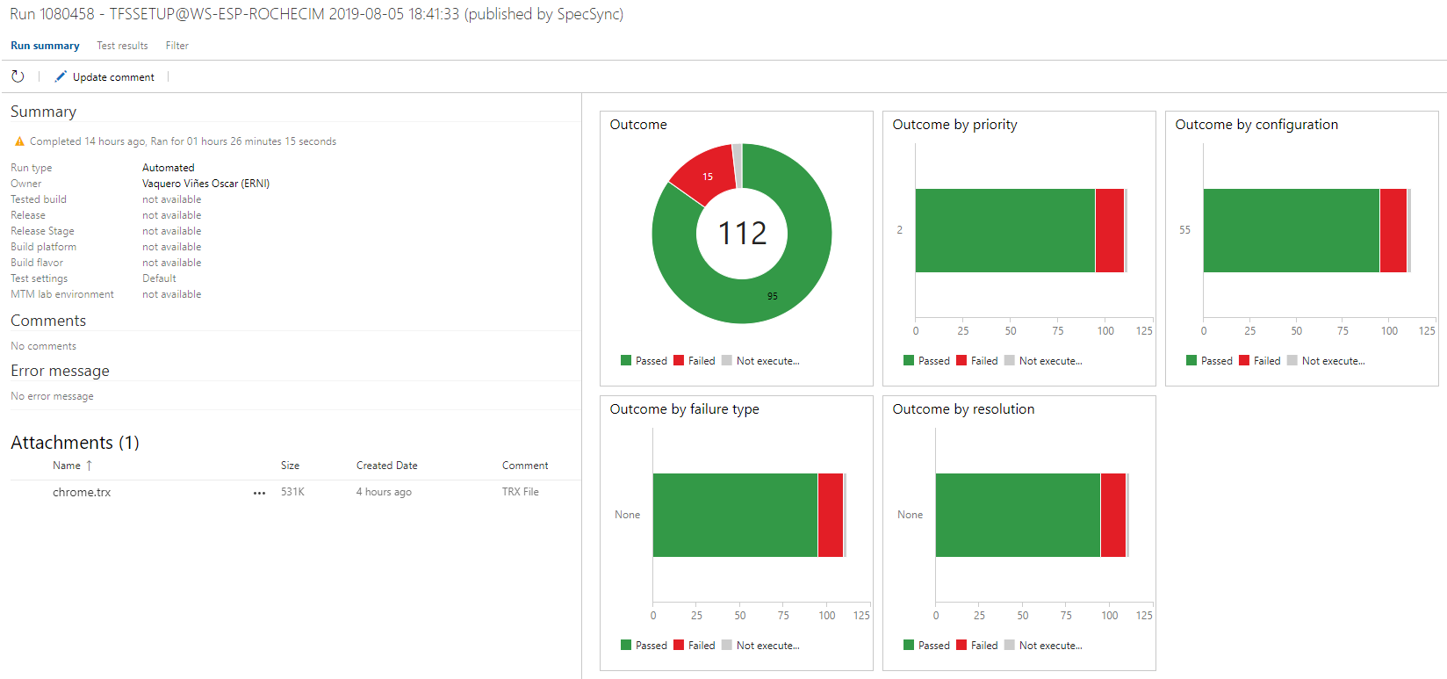
04. Continuous Integration over Azure Environment
4.3 SpecSync – Publish Test Results

Slide 11
01. UI Web based application Automation
Selenium: How to Start a New Project
CI over Azure
Pipelines & Reporting

Slide 12
04. Continuous Integration over Azure Environment
4.4 Pipelines
Selenium-Grid allows you run your tests on different machines against different browsers in parallel. That is, running multiple tests at the same time against different machines running different browsers and operating systems. Essentially, Selenium-Grid support distributed test execution.

Slide 13
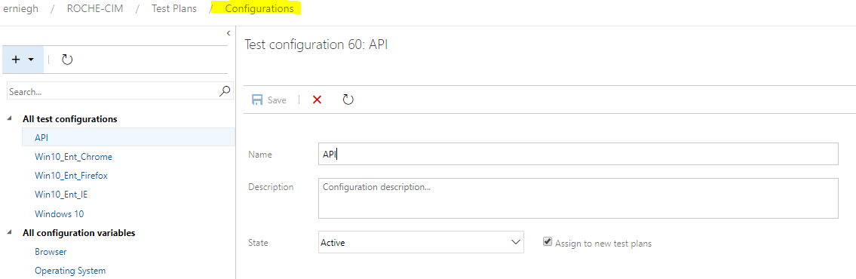
04. Continuous Integration over Azure Environment
5.4 Test Plans: Configurations

Slide 14
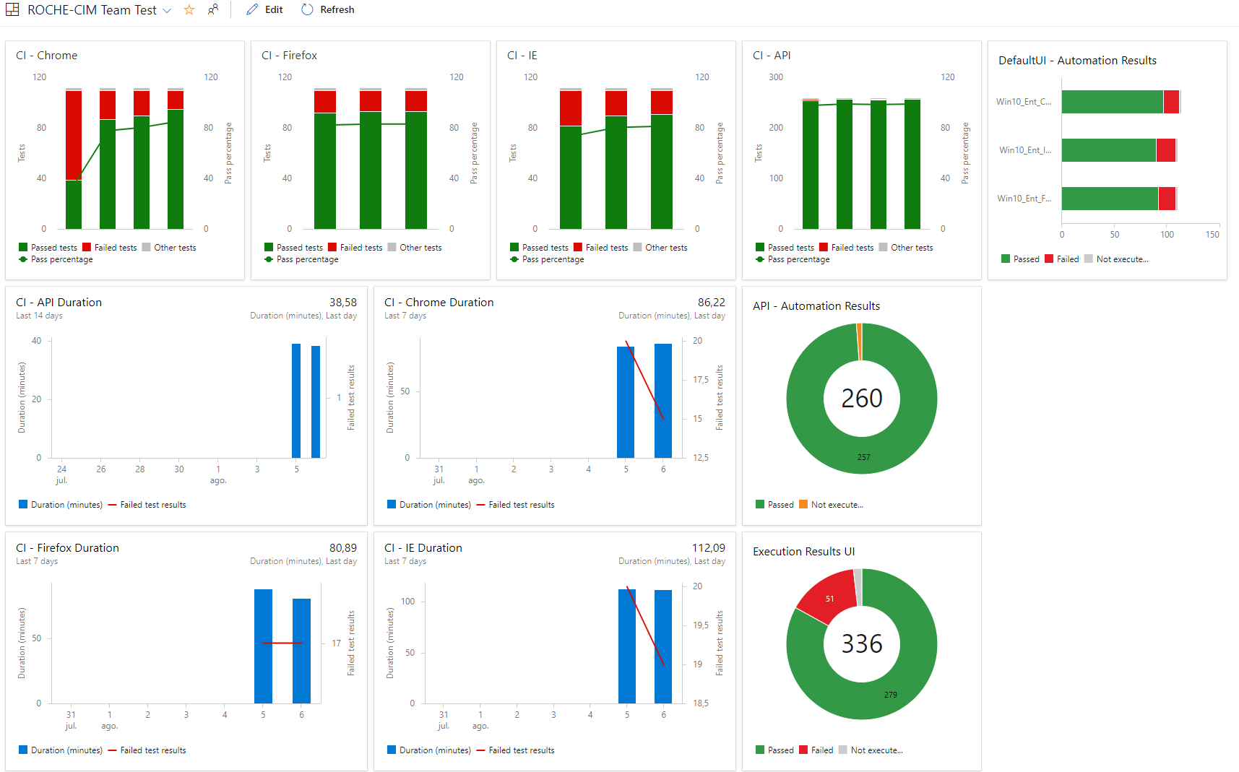
04. Continuous Integration over Azure Environment
5.4 Reporting

Slide 15

Diego Martínez Gilabert
diegomartinezgilabert@erni-espana.es

